Slide 1
welcome
ANNAI WOMEN’S COLLAGE,
PUNNAMCHATRAM,
KARUR.

Slide 2
PROJECT TOPIC TRACING THE OF THE GLOBAL COMMUNITY: A POPULGROWTH ATION FORECASTING ANALYSIS
Faculty Mentor
Mrs.K.Gomathi Msc, MPhil,Asst.Professor

Slide 3
III – B.SC MATHEMATICS
LEADER - KAVISHRI.S
MEMBERS - KEERTHANA.V
KEERTHANA.K
KARTHIKA.P

Slide 4
INTRODUCTION Global population growth is determined by the number of births and deaths. Improving health is increasing the size of the population as it is decreasing mortality.
To calculate the growth rate, take the current value and subtract that from the previous value. Next, divide this difference by the previous value and multiply by 100 to get a percentage representation of the rate of growth.

Slide 5
Empathy map Use this framework to develop a deep, shared understanding and empathy for other people. An Empathy map helps describe the aspects of a user's experience, needs and pain points, to quickly understand your users’ experience And mindset.

Slide 6


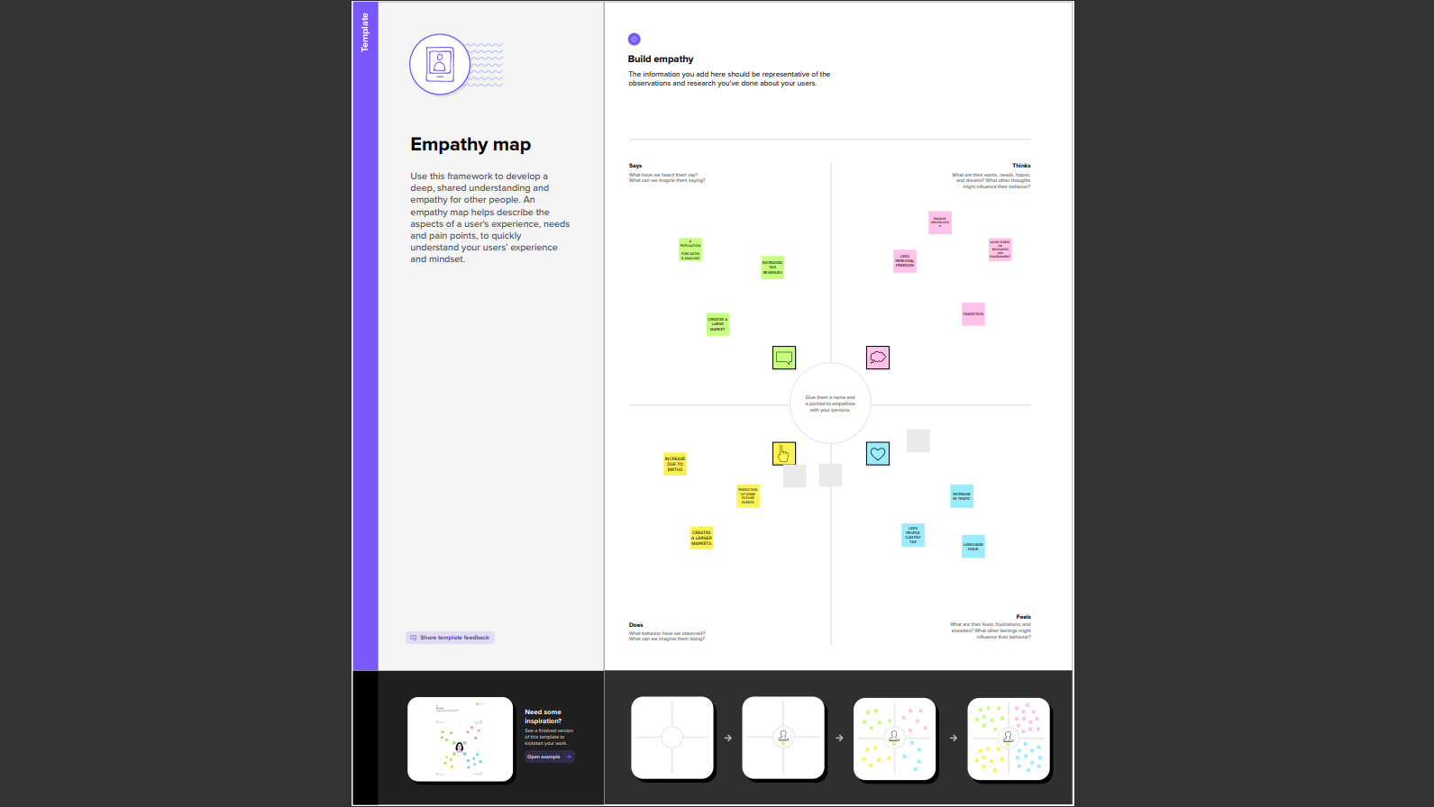
EMPATHY MAP

Slide 7
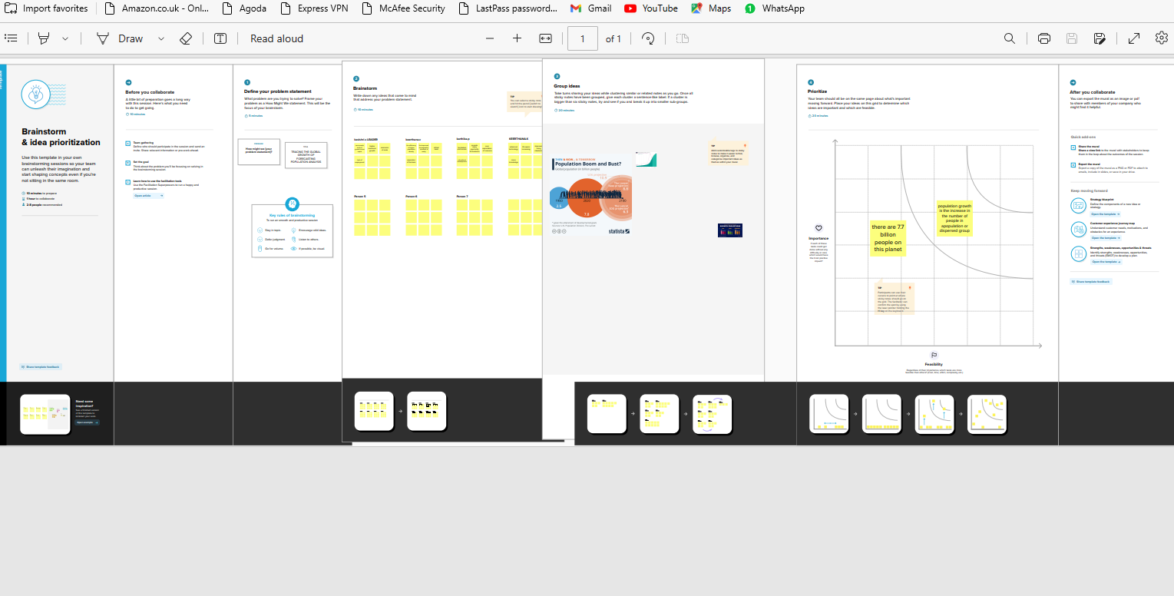
BRAINSTORM

Slide 8
Data Visualization
Data visualization is the process of creating graphical representations of data in order to help people
understand and explore the information. The goal of data visualization is to make complex data sets
more accessible, intuitive, and easier to interpret. By using visual elements such as charts, graphs,
and maps, data visualizations can help people quickly identify patterns, trends, and outliers in the
data.

Slide 9
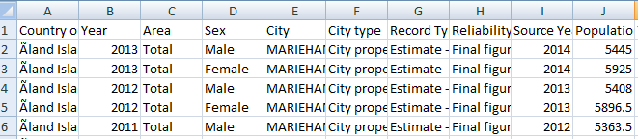
dataset

Slide 10
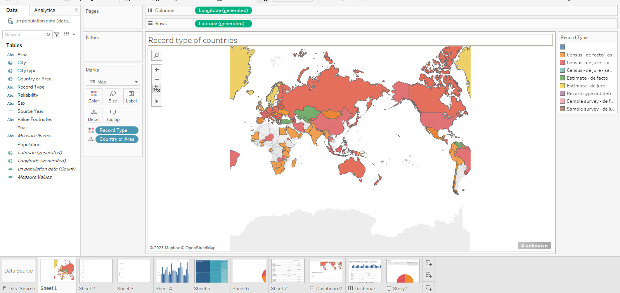
ACTIVITY:01 POPULATION RECORDS BY TYPES OF COUNTRIES

Slide 11
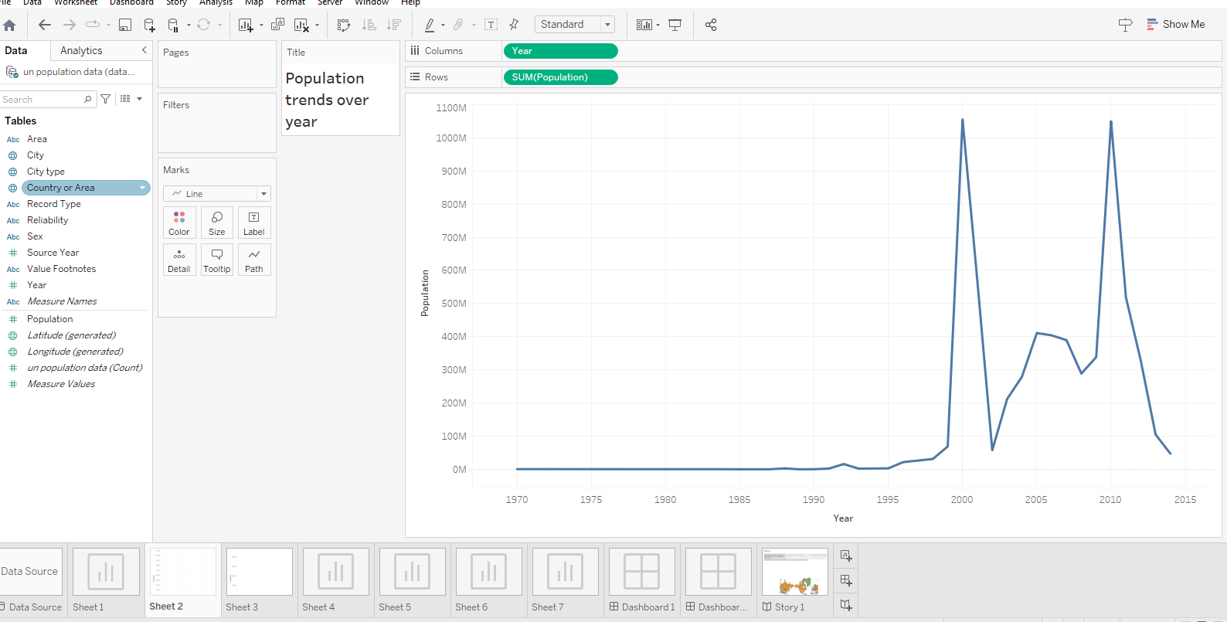
ACTIVITY: 02 POPULATION TRENDS OVER THE YEARS

Slide 12
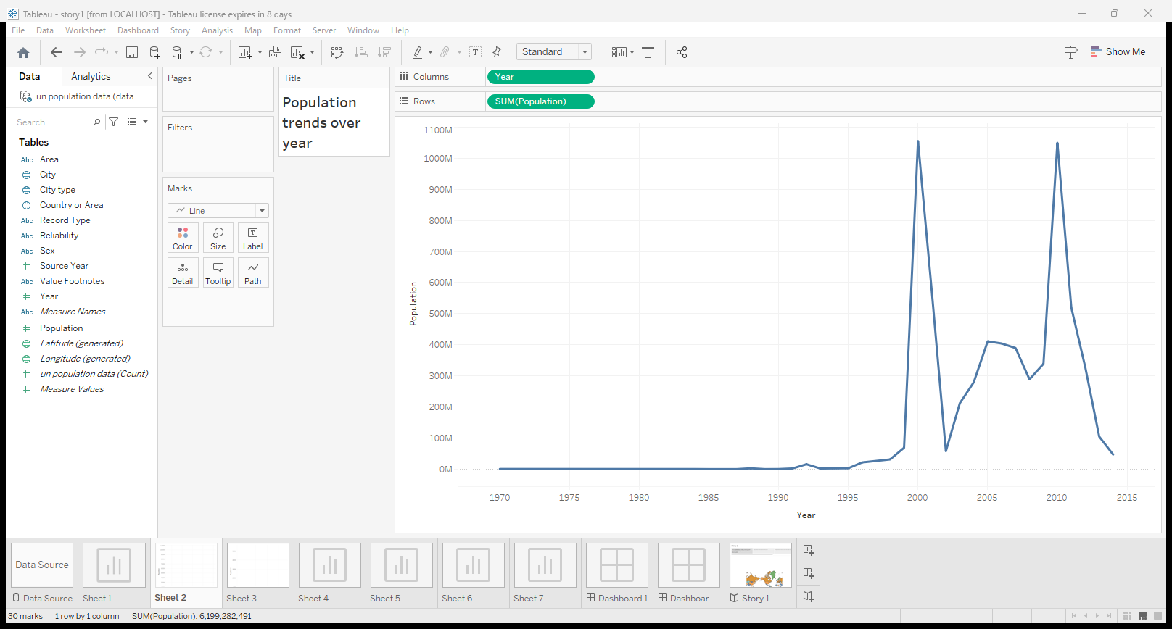
ACTIVITY: 03 POPULATION TRENDS OVER THE YEARS BY SEX

Slide 13
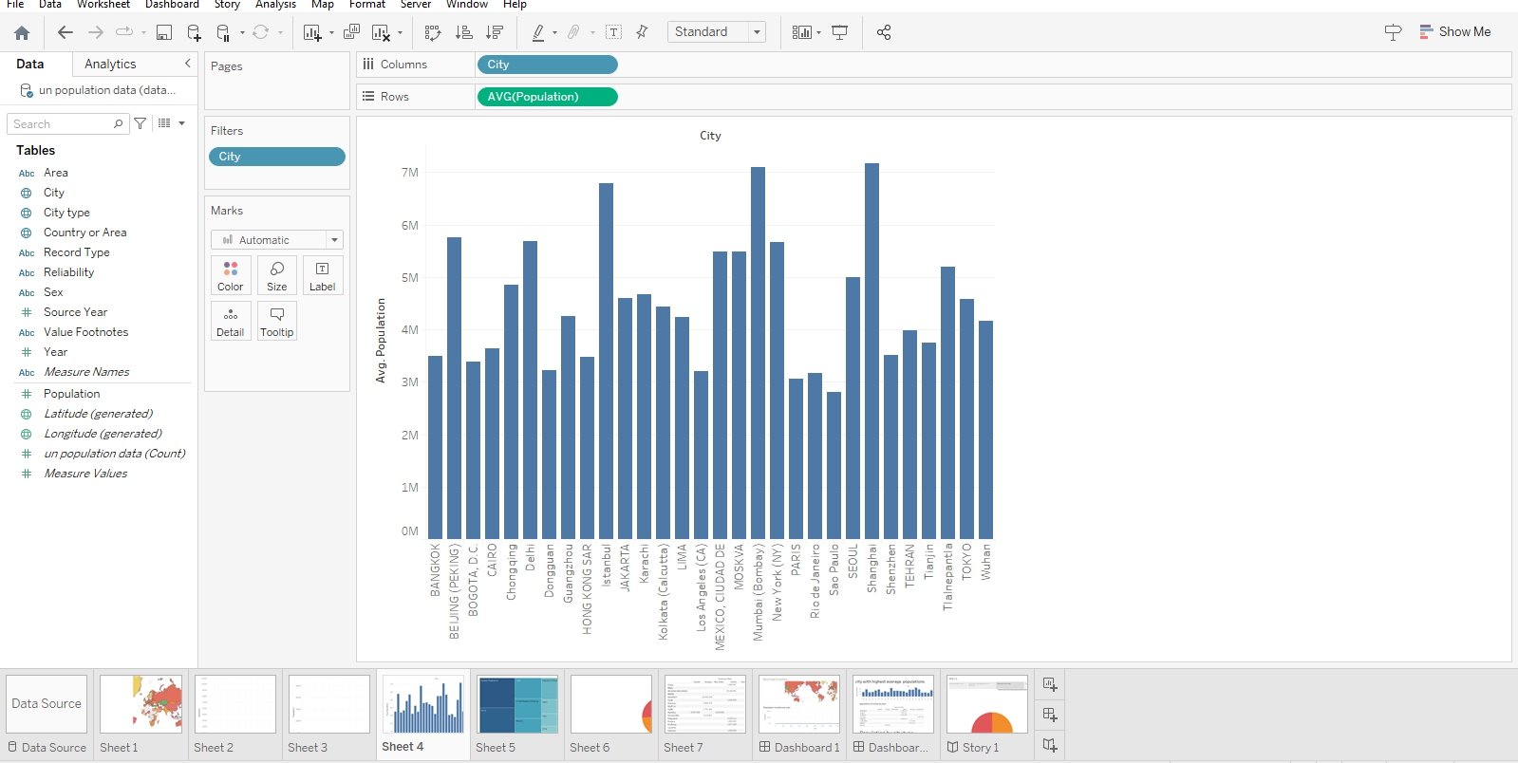
ACTIVITY: 04 CITIES WITH HIGHEST AVERAGE POPULATIONS

Slide 14
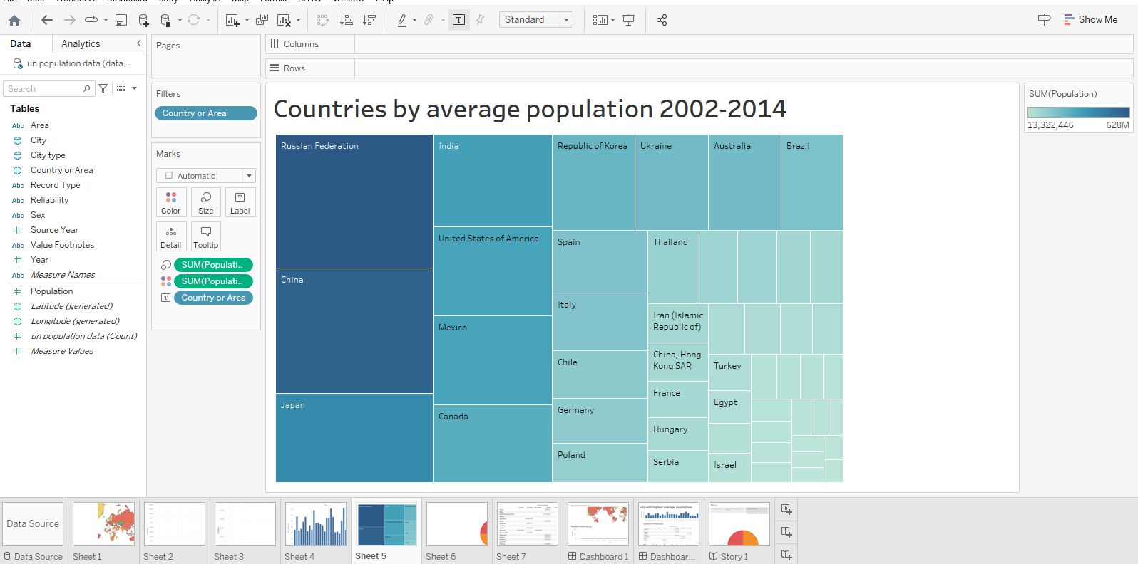
ACTIVITY: 05 COUNTRIES WITH HIGHEST AVERAGE POPULATION FROM 2000 - 2014

Slide 15
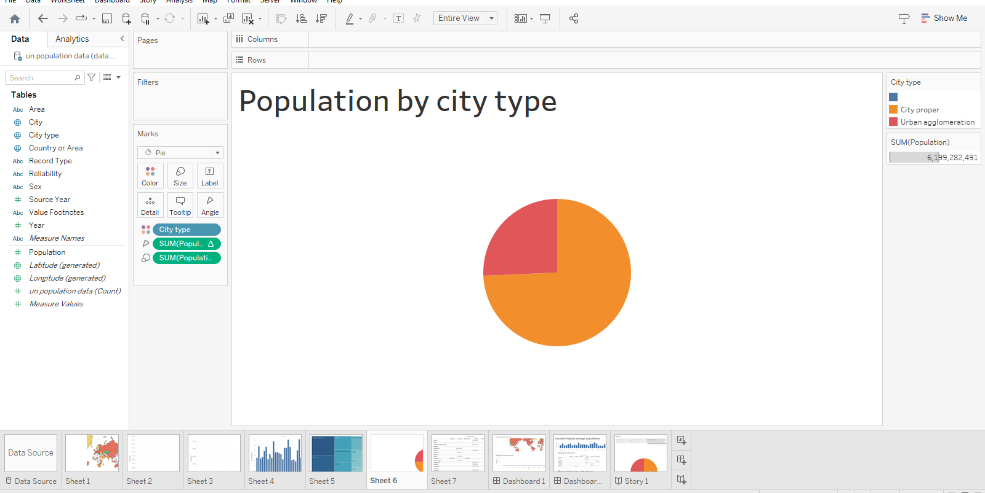
ACTIVITY: 06 POPULATION BY CITY TYPE

Slide 16
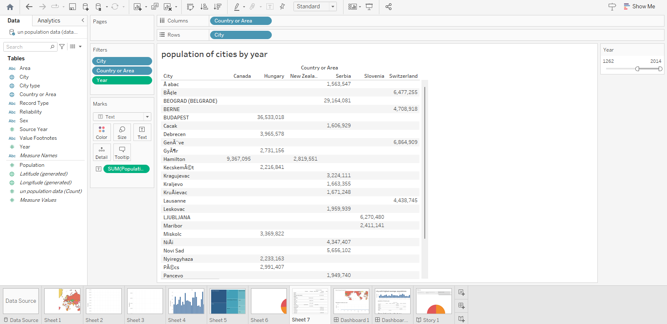
ACTIVITY: 07 POPULATION OF CITIED BY YEAR

Slide 17
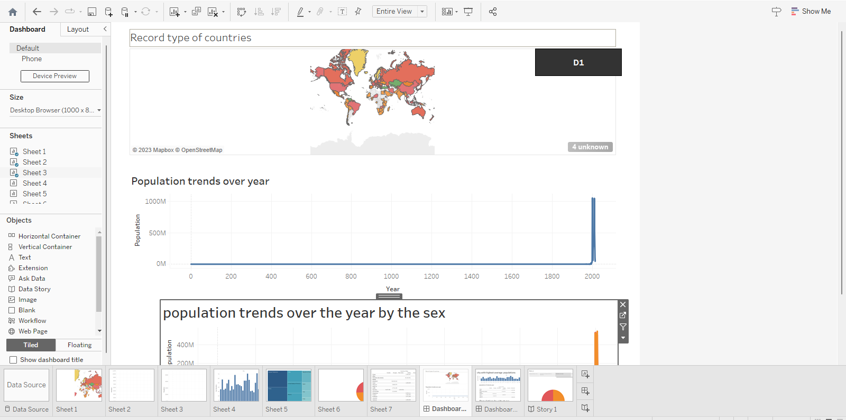
DASHBOARD - 01

Slide 18
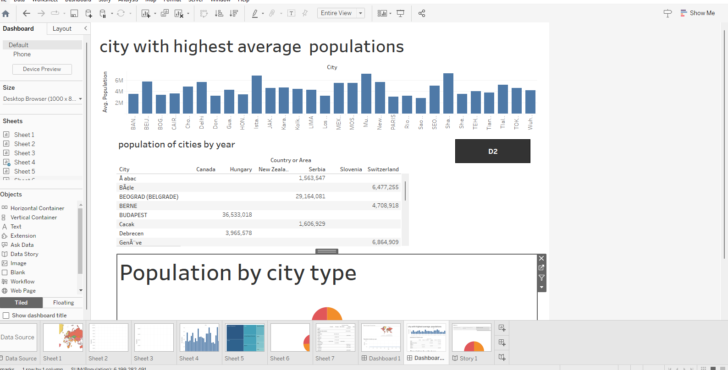
DASHBOARD - 02

Slide 19
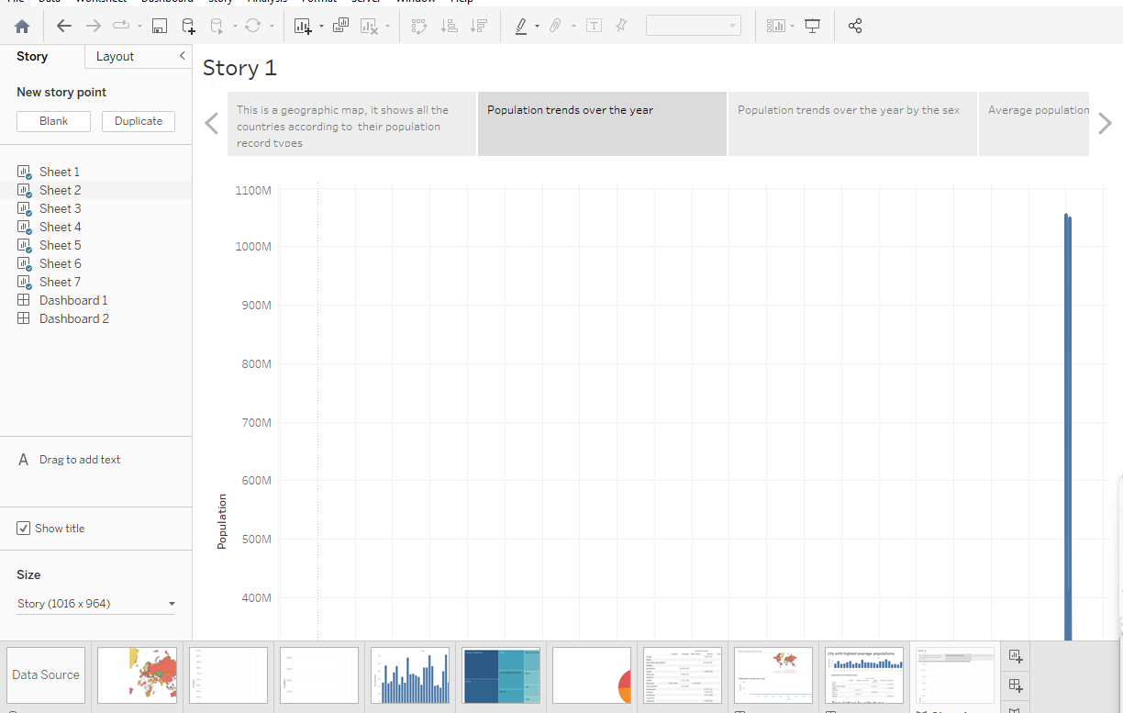
STORY TRACING THE GROWTH OF THE GLOBAL COMMUNITY: A POPULATION FORECASTING ANALYSIS

Slide 20
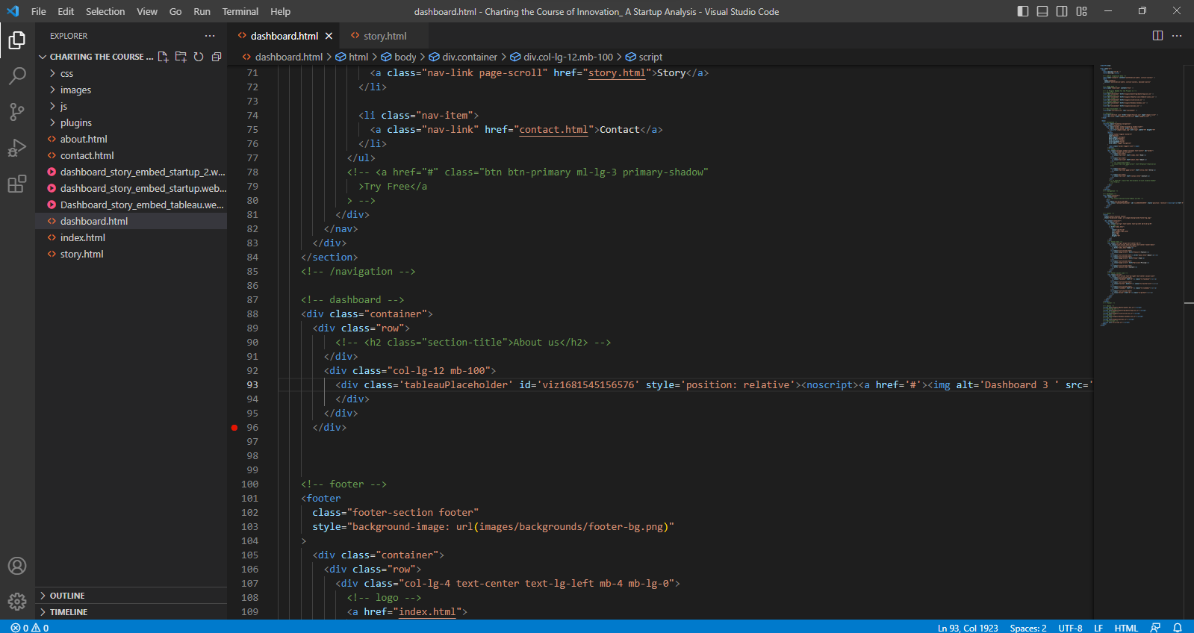
HTML – DASHBOARD & STORY

Slide 21
Advantage and disadvantage
Over the course of history, the world has seen rapid population growth. It has enabled a rich diversity of culture, technology and improved living standards. However, population growth is increasingly coming at a cost – in particular to the environment. High population levels are contributing to the depletion of natural resources and causing widespread pollution. Some fear population growth is now deeply damaging for both the planet and even the survival of many natural habitats. However, others argue that fears other population growth are misplaced with the planet having room for more people, so long as we learn to live more in harmony with nature and more efficiently in big cities.

Slide 22
THANK YOU

